Slide 1

Student Register Application
a presentation by
1.
2.

Slide 2
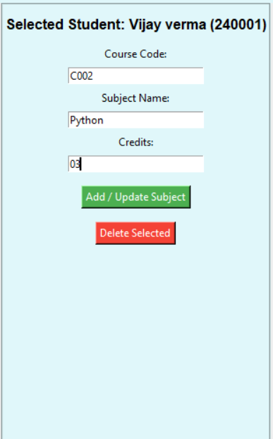
INTRODUCTION
The Student Register Application is a software tool designed to simplify and automate the process of managing student information in educational institutions.
It replaces manual record-keeping with a digital database that stores student details securely and efficiently.
The application aims to reduce errors, save time, and provide quick access to student data for teachers and administrators.
This project focuses on creating a user-friendly interface for easy student registration, modification, and search functionalities.

Slide 3
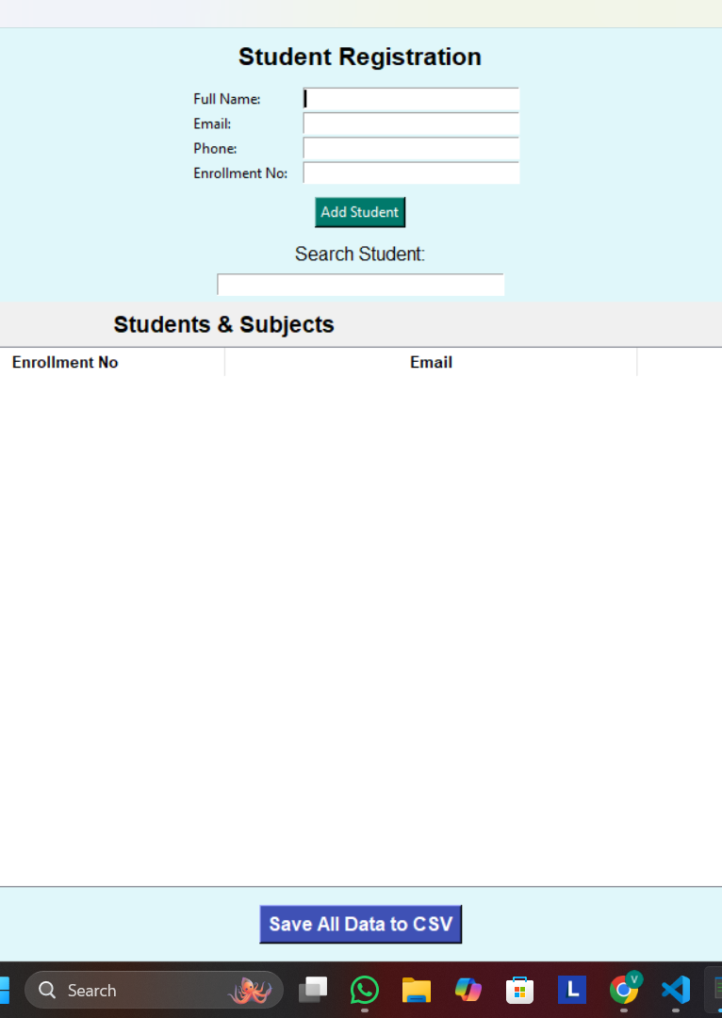
Blueprint & General View
Blueprint (Project Design)
User Interface (UI): Simple and intuitive form-based interface for easy student registration and data management.
Database: Stores student information such as name, roll number, class, contact details securely.
Core Modules:
Student Registration
Edit/Update Records
Search Student
Delete Records
Data Validation: Ensures accurate and complete data entry before saving.
Reports: Optionally generate lists or reports (if your app includes this).

Slide 4
General View (How It Works)
The user opens the application and navigates to the registration form.
Enters student details and submits the form.
The system validates and stores the data in the database.
Users can search, edit, or delete records as needed.
The application maintains a clean and organized database accessible to authorized users.
Simple Flowchart:
User → Form → Validation → Database → Search/Edit/Delete

Slide 5

CODE

Slide 6
CODE

Slide 7
CODE

